Slide 1

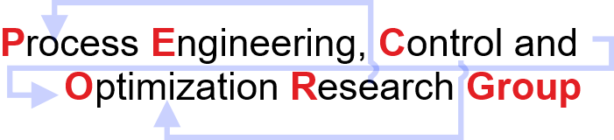
Model Predictive Control On An
Arduino Device
Subhi Gupta and Hari S. Ganesh
Chemical Engineering
PSE ASIA 2022

Slide 2

Content
Introduction to Temperature Control Lab (TCLab)
System Modeling and Identification
Model Predictive Control (MPC) on TCLab
Data Driven State Space Equations
Parametric and Multiparametric programming
Explicit MPC (mp-MPC) on TCLab
Bilevel Model Predictive Control (BMPC)
Bilevel Programming problems (BLPP)

Slide 3
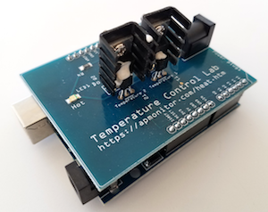
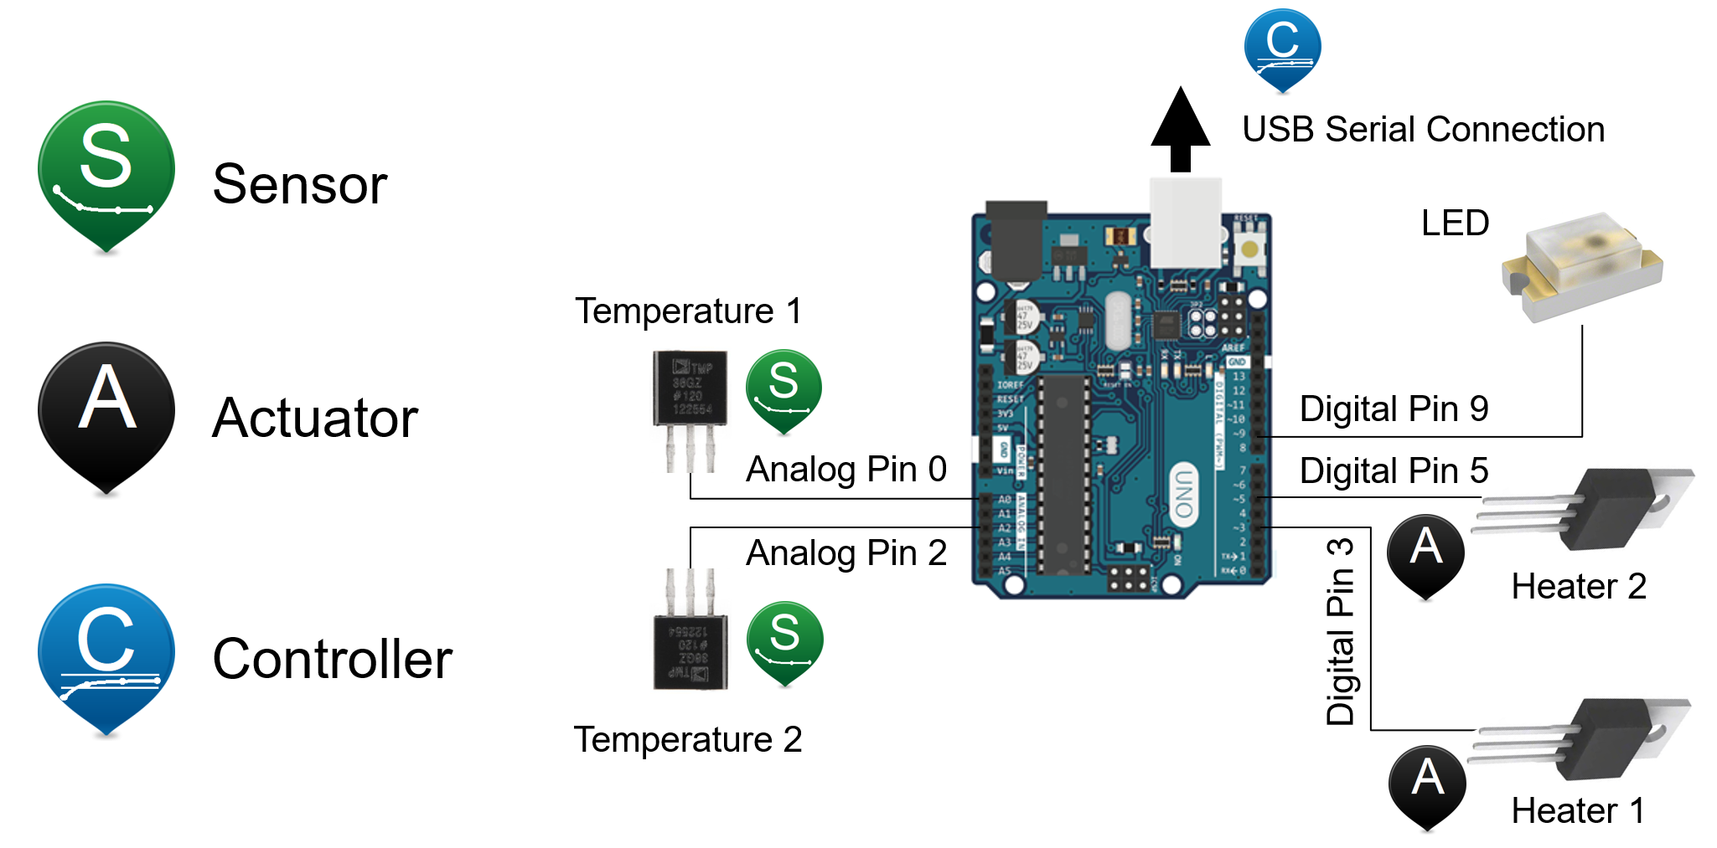
Temperature Control Lab (TCLab)
Introduction
An application of feedback control with an Arduino, an LED, two heaters, and two temperature sensors.
A MIMO device for understanding the principles of modeling, estimation, and control.
Heaters
Epoxy
Temperature Sensors
Temperature sensors and heater transistors with connections to an Arduino Leonardo.
Image Source Link: http://apmonitor.com/pdc/index.php/Main/ArduinoTemperatureControl

Slide 4
Temperature Control Lab (TCLab)
Working Principle
Implementation of control algorithm
Data Acquisition (conversion of analog signal to a digital signal to be understood by software)
PC
(MATLAB/SIMULINK)
Microcontroller board for hardware and software communication.
ARDUINO UNO
Analog output control
Analog
Signal
PWM
(0-100%)
POWER SUPPLY DC
HEATER
TIP41C
TEMPERATURE SENSOR (LM35)
Reference: Application of different control algorithms on a ‘home-made’ temperature control lab kit.
Reference: https://apmonitor.com/pdc/index.php/Main/TCLabSensor
Reference: The basics of Arduino: Reading Voltage- Device Plus
.
.

Slide 5
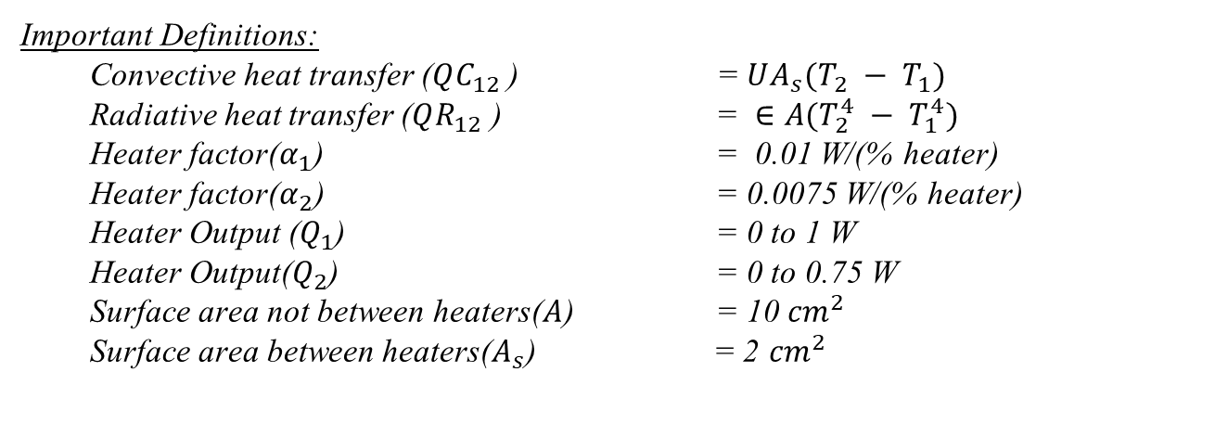



System Modeling and Identification
Dual Heater Modeling of TCLab (MIMO System)
Two energy balance equations that describe the dynamic temperature response
Convective Heat Transfer
Heater 1
$${(T}_{1})$$
Heater 2
$${(T}_{2})$$
Radiative Heat Transfer
$$T_{∞}$$
Reference link: apmonitor.com/do (John D. Hedengren)

Slide 6
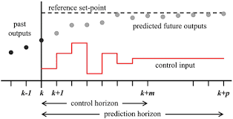
Model Predictive Control
Introduction
MPC Controller
(Objective Function + Model + Constraints)
Reference
Plant
State Estimator
MPC solves an optimization problem at each k^{th} time step
Formulation
Quadratic Programming (QP) Problem
Image Source link: Wikipedia

Slide 7

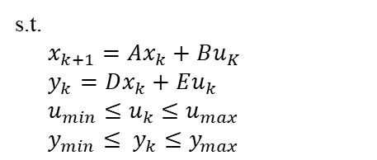
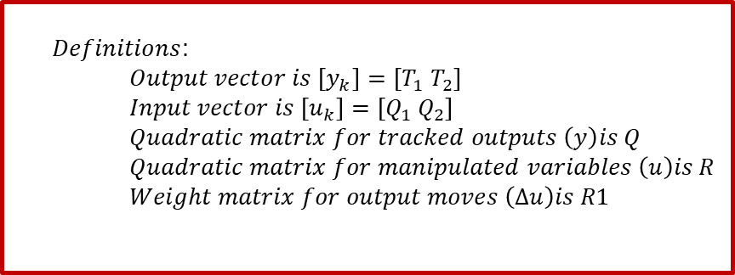
Linear Model Predictive Control on TCLab
Formulation
Objective function
$$\min{Σ {\left(y_{k}− y_{k}^{R}\right)}^{T} Q_{k}\left(y_{k}− y_{k}^{R}\right)+Σ{\left(u_{k}−u_{k}^{R}\right)}^{T}R_{k}\left(u_{k}−u_{k}^{R}\right)+ ΣΔu_{k}^{T}{R1}_{k}(Δu_{k})}$$
System Model
Constraints
$Definitions$: $Output vector is \left[y_{k}\right]=\left[T_{1}{ T}_{2}\right]$ $Input vector is \left[u_{k}\right]=\left[Q_{1}{ Q}_{2}\right]$ $Quadratic matrix for tracked outputs \left(y\right)is Q$ $Quadratic matrix for manipulated variables \left(u\right)is R$ $Weight matrix for output moves \left(Δu\right)is R1$
At each sampling instant the quadratic problem was solved using cplexqp solver.

Slide 8


Data-Driven State Space Equations
System Identification
The differential equations representing the physical system were first linearized around the steady-state point.
MATLAB System Identification Toolbox
(Data-Driven Toolbox)
The Step Response Analysis method was employed to obtain the data.
TCLab System captured using linear dynamics
The resulting pseudo states equations obtained in matrix form were used as linear constraints in MPC formulation.

Slide 9
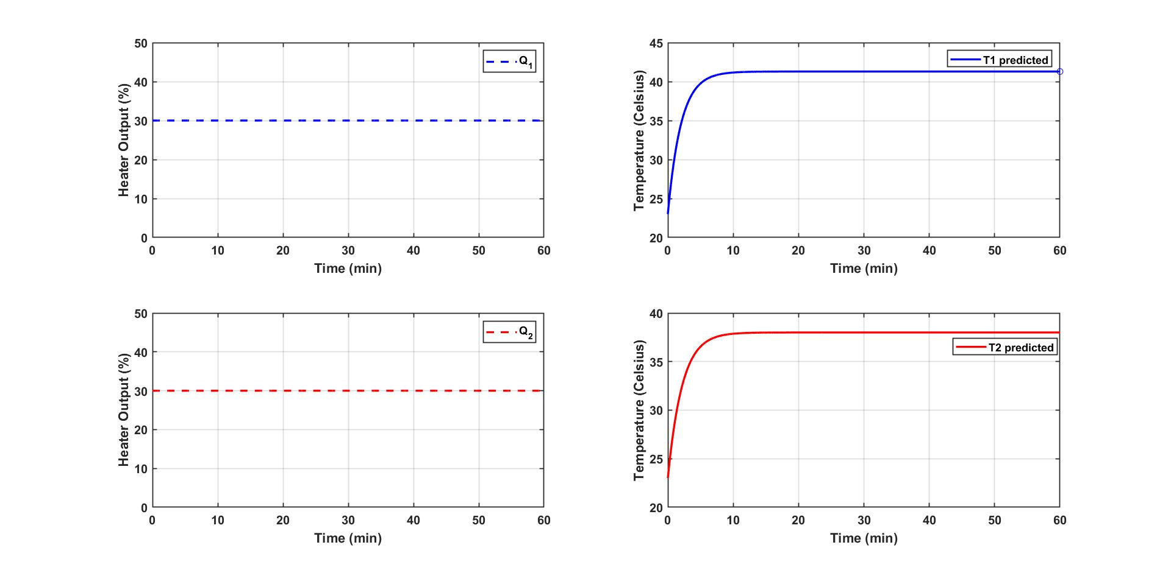
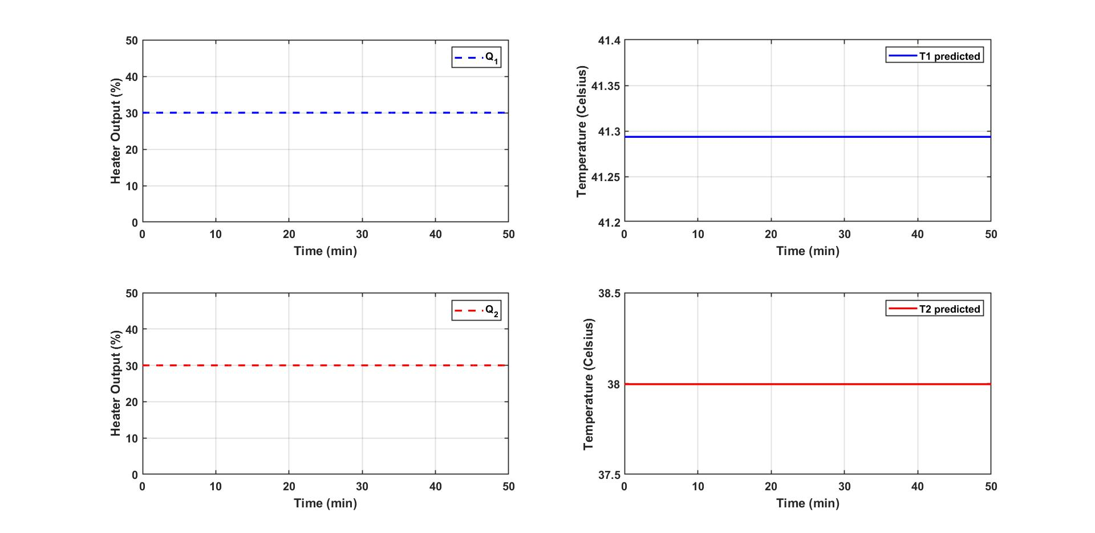
Data Driven State Space Equations
Steady State Response
Steady-state achieved for Q1=30 and Q2=30
Steady-state achieved for Q1=30 and Q2=30

Slide 10
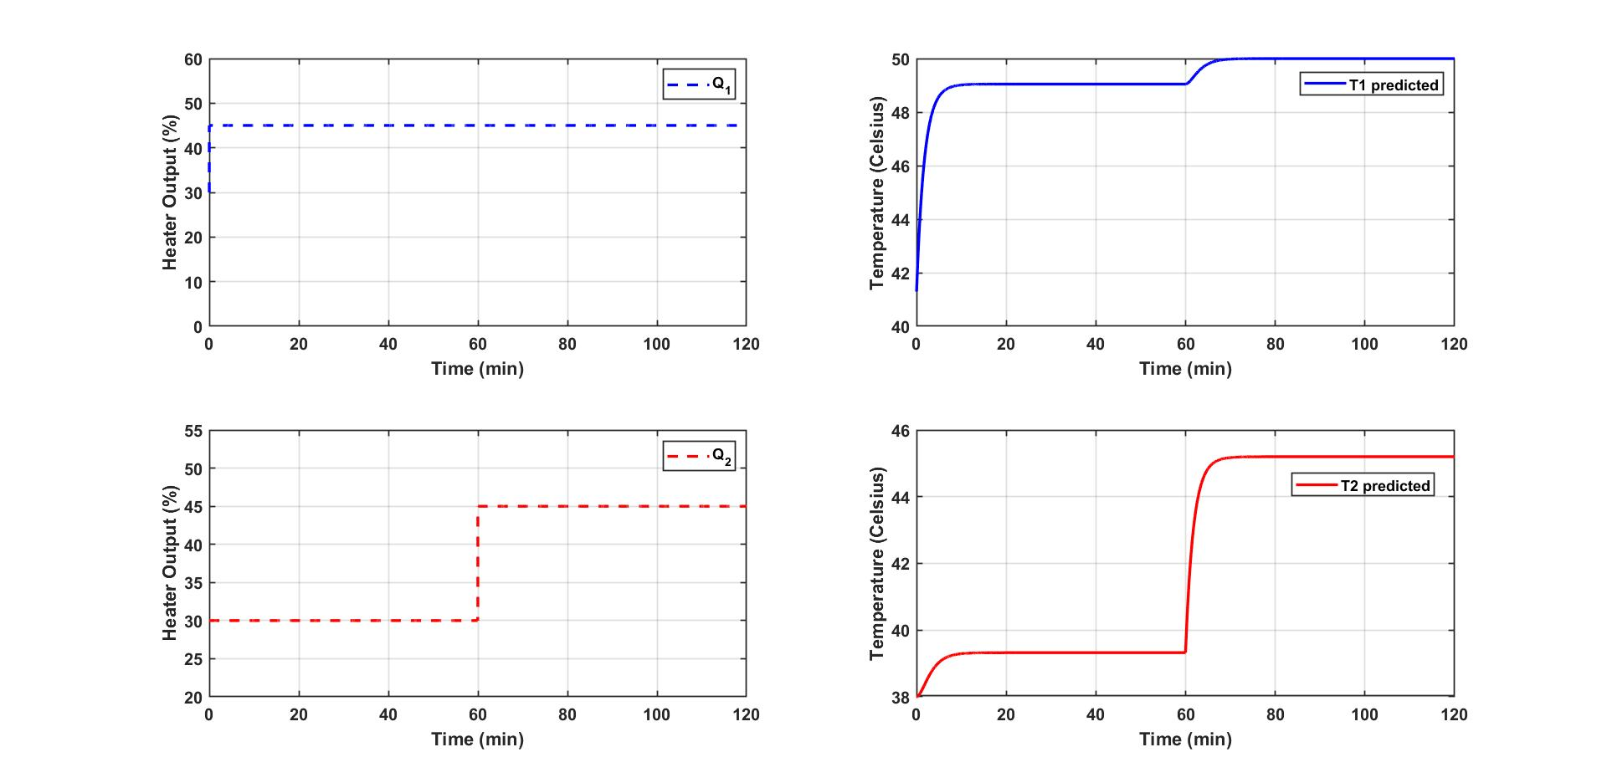
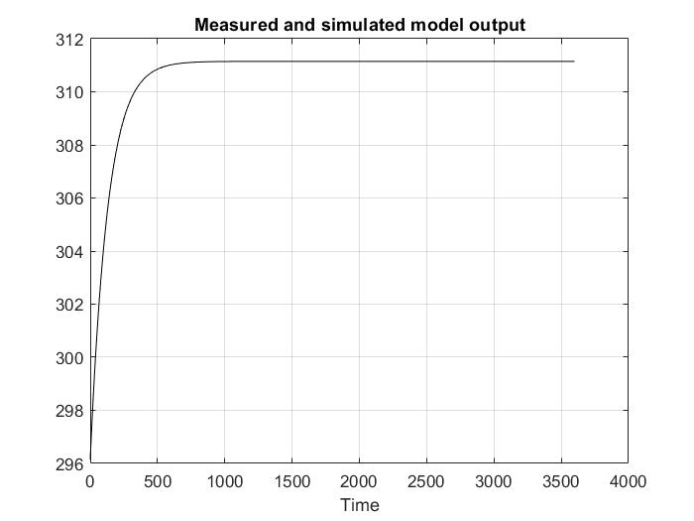
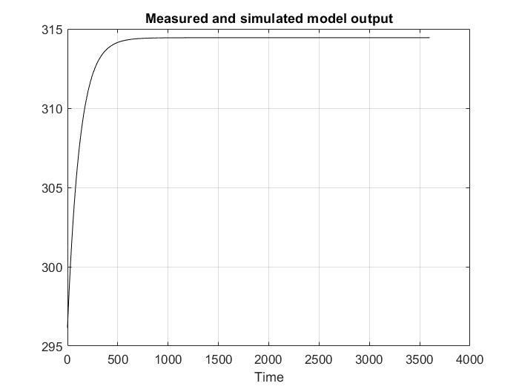

Data Driven State Space Equations
Step Response Analysis
Temperature simulation for step changes in Q1 and Q2
Number of states identified=4
$$y_{1}$$
$$y_{2}$$
.

Slide 11
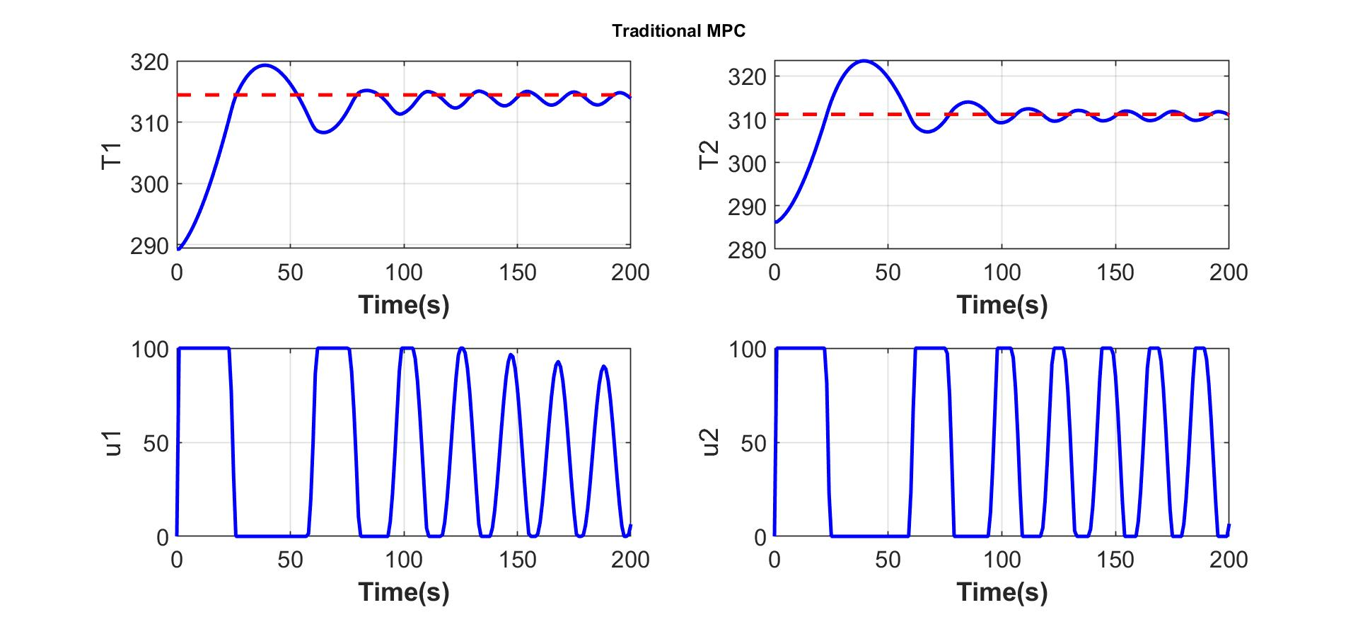
Closed-loop Simulation
Online MPC Control Calculations
Online MPC
Solving Online MPC is computationally complex.
Explicit MPC can greatly simplify runtime operation.
MPC formulation was solved multi-parametrically (mp-MPC).

Slide 12


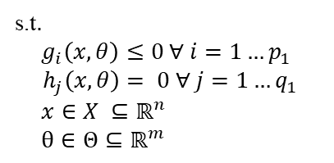
Parametric Programming
An Effective Solution Strategy
Takes into account varying parameters (𝜃).
Approach is to obtain the optimal solution (𝒙) as an explicit function of the parameters.
General parametric nonlinear programming problem
To solve such programming problems
POP toolbox was used in our work.
Reference: Faísca NP, Dua V, Pistikopoulos EN. 2007 Feb 9;1:1-23.
Image Source: https://parametric.tamu.edu/POP/

Slide 13
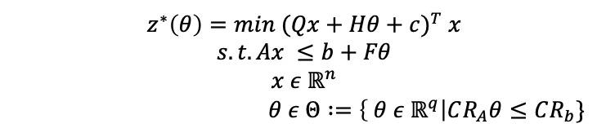
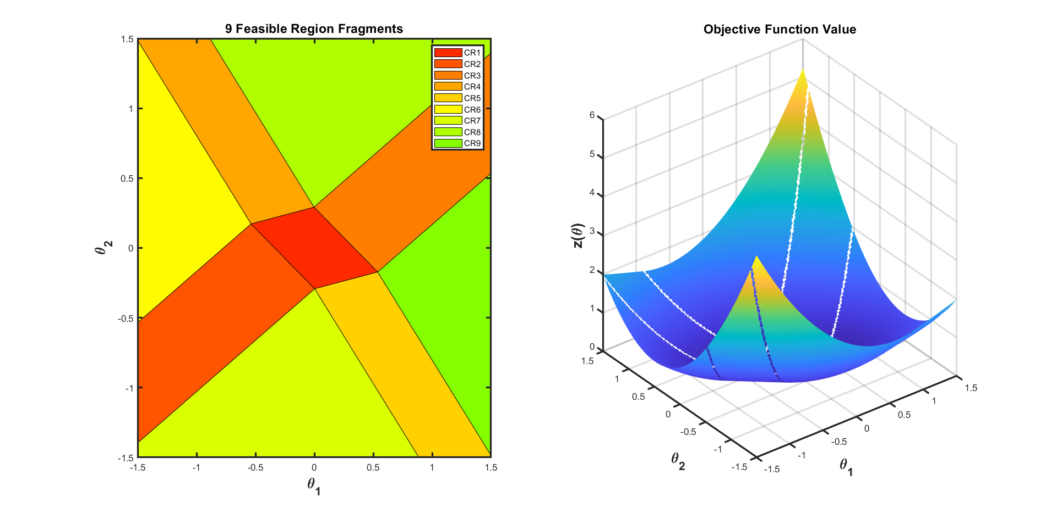
Multiparametric Programming
Formulation of Multiparametric Linear (mp-LP) and Quadratic Programming (mp-QP)
Solution of mp-QP: 𝒙(𝜃)^{𝘪}=𝑊^{𝘪}𝜃 + 𝘸 CR^{𝘪}: Φ^{𝘪}𝜃≤𝜙^{𝘪}
The parameter space(𝜃 ) is characterised into
nine set of critical regions (CR_{i}).
Each critical region has its own function optimal solution x*(𝜃 ) and Z*(𝜃 )
Reference: Faísca NP, Dua V, Pistikopoulos EN. 2007 Feb 9

Slide 14
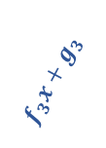
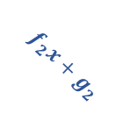
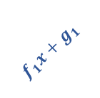

Explicit MPC
Advantages
Solves the optimization problem offline for all the states within a range.
Optimal solution is precomputed for each state within a range offline.
At each time step the region in which the current state lies is searched and then the linear function is evaluated to get the current control action.
u(x)
$$f_{1}x+g_{1 }$$
$$f_{3}x+g_{3 }$$
$$f_{1}x+g_{1 } 0<x<a$$
$f_{2}x+g_{2}$ $a≤x<b$
$$f_{3}x+g_{3 }b≤x<c$$
$$f_{2}x+g_{2}$$
u(x)
a
b
c
x
Solution space is divided into several regions
Each region is mapped into unique optimal solution
Reference: Tøndel P, Johansen TA, Bemporad A. An algorithm for multi-parametric quadratic programming and explicit MPC solutions.

Slide 15

Closed Loop Simulation Results
Verification and Comparison
Online MPC
mp-MPC
Online MPC and mp-MPC results match.
No. | Type of MPC | Total runtime (s)
1 | Online MPC | 5.351
2 | mp-MPC | 0.912
Comparison based on runtime operation.
Runtime operation reduced by 83.52%.

Slide 16
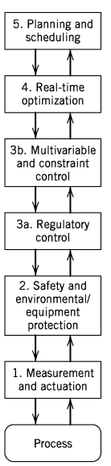
Bilevel Model Predictive Control (BMPC)
Solving MPC in hierarchical manner
Controller 1 (Optimisation Problem 1)
Model predictive control (MPC) strategy.
Controller 2 (Optimisation Problem 2)
Standard feedback and feedforward control techniques.
System
Application of Bilevel
Hierarchical model Predictive Control (MPC) structure
To measure process variables and implement the calculated control actions.
Use of a multi-parametric bi-level algorithm
for the development of
Explicit Hierarchical Controllers.
Hierarchy of process control activities
Avraamidou S, Pistikopoulos EN.In Computer aided chemical engineering 2017 Jan 1.Elsevier.
16

Slide 17

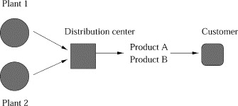





Bilevel Programming Problem (BLPP)
Bilevel Optimization Model
Leader’s problem or
High level decision problem
Follower’s problem or
Low level decision problem
Aim is to minimise both Production cost and distribution cost.
Process configuration of an enterprise
First level (production model) is constrained by another optimization problem (second level,the distribution model).
Reference: Ryu JH, Dua V, Pistikopoulos EN. 2004 Jun 15

Slide 18







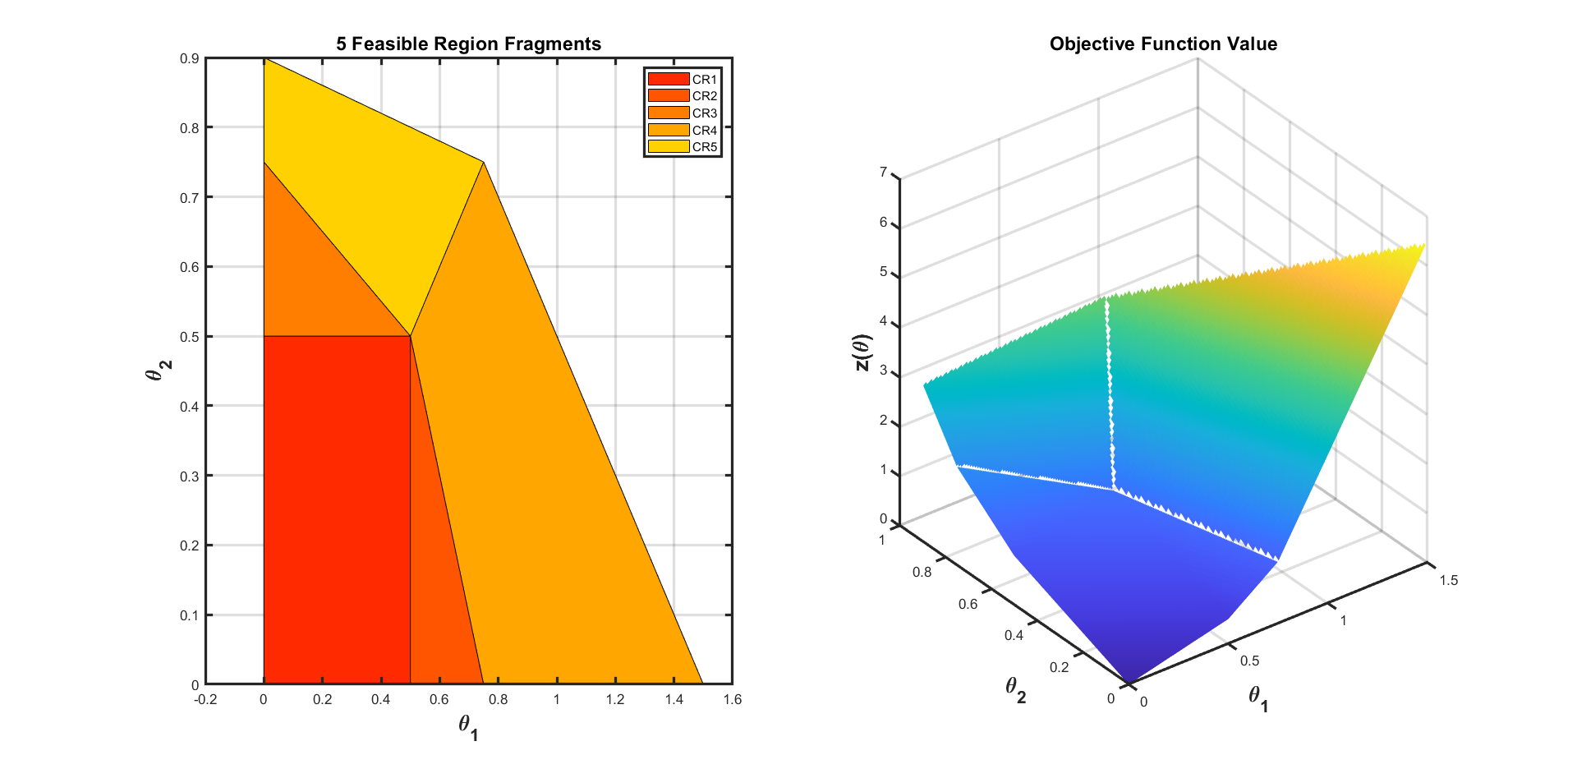
Bilevel Programming Problem (BLPP)
Formulation of Linear BLPP (LP/BLPP)
Five critical regions are obtained with y as an explicit function of x.
Inner Level solved multi-parametrically
Reference: Faísca, Nuno P., et al. Journal of Global Optimization 38.4 (2007).

Slide 19
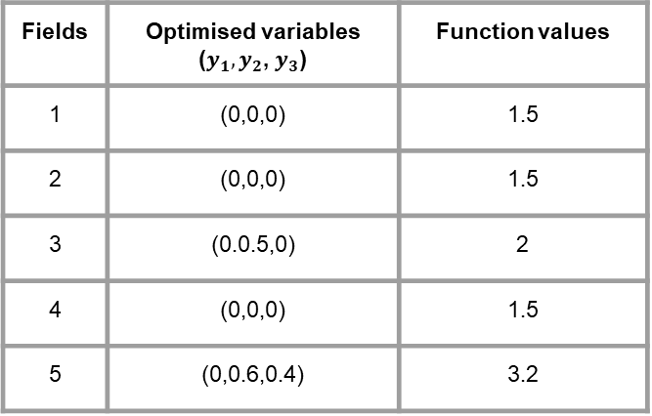
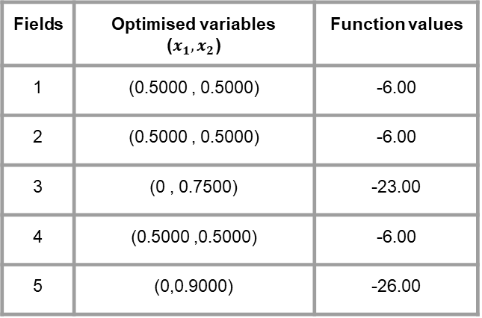
Bilevel Programming Problem (BLPP)
Solution of a linear bilevel programming problem.
The solution obtained after solving five LP outer level problem
Fields | Optimised variables ($x_{1},x_{2}$) | Function values
1 | (0.5000 , 0.5000) | -6.00
2 | (0.5000 , 0.5000) | -6.00
3 | (0 , 0.7500) | -23.00
4 | (0.5000 ,0.5000) | -6.00
5 | (0,0.9000) | -26.00
Substitution of optimized variables to get solutions to inner-level problems.
Fields | Optimised variables ($y_{1},y_{2}$, $y_{3}$) | Function values
1 | (0,0,0) | 1.5
2 | (0,0,0) | 1.5
3 | (0.0.5,0) | 2
4 | (0,0,0) | 1.5
5 | (0,0.6,0.4) | 3.2
Global optimum solution

Slide 20
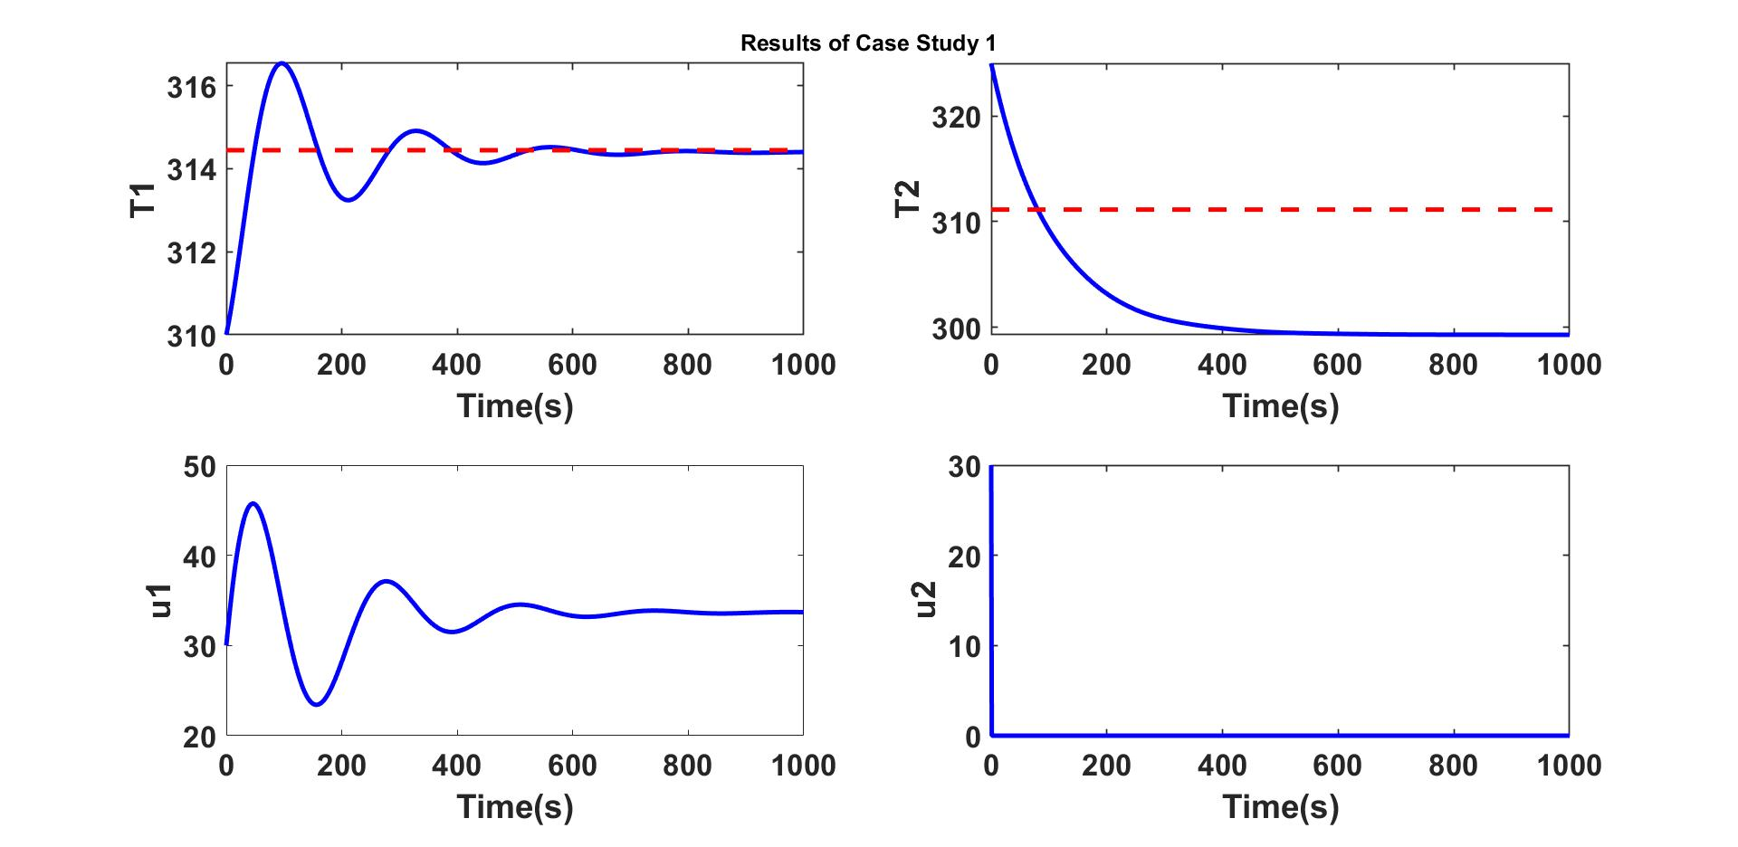
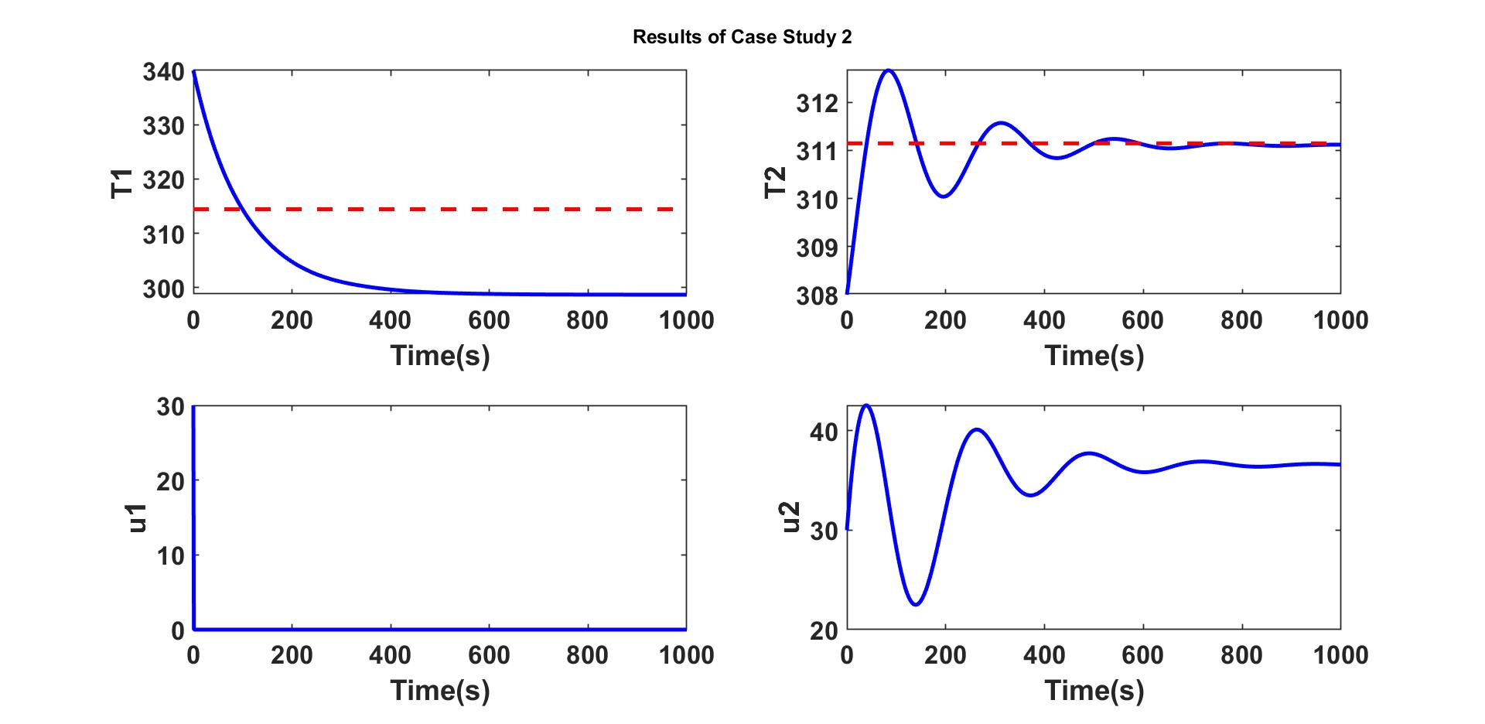

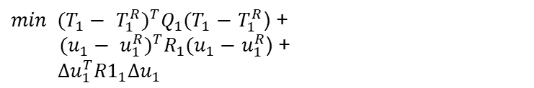


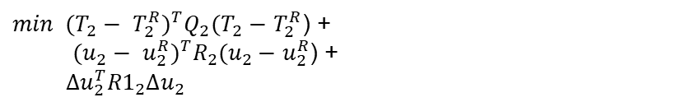


Bilevel Model predictive control (BMPC)
Explicit Hierarchical Controller on TCLab
$$\min{u_{1}+ u_{2}}$$
$$u_{2}$$
${min (T_{1}− T_{1}^{R})}^{T}Q_{1}(T_{1}−$ $T_{1}^{R}$) +
${ (u_{1}− u_{1}^{R})}^{T}R_{1}(u_{1}−$ $u_{1}^{R}$) +
$Δu_{1}^{T}{R1}_{1}Δu_{1}$
$$u_{1}$$
Case Study 1
$$\min{u_{1}+ u_{2}}$$
$$u_{1}$$
${min (T_{2}− T_{2}^{R})}^{T}Q_{2}(T_{2}−$ $T_{2}^{R}$) +
${ (u_{2}− u_{2}^{R})}^{T}R_{2}(u_{2}−$ $u_{2}^{R}$) +
$Δu_{2}^{T}{R1}_{2}Δu_{2}$
$$u_{2}$$
Case Study 2

Slide 21
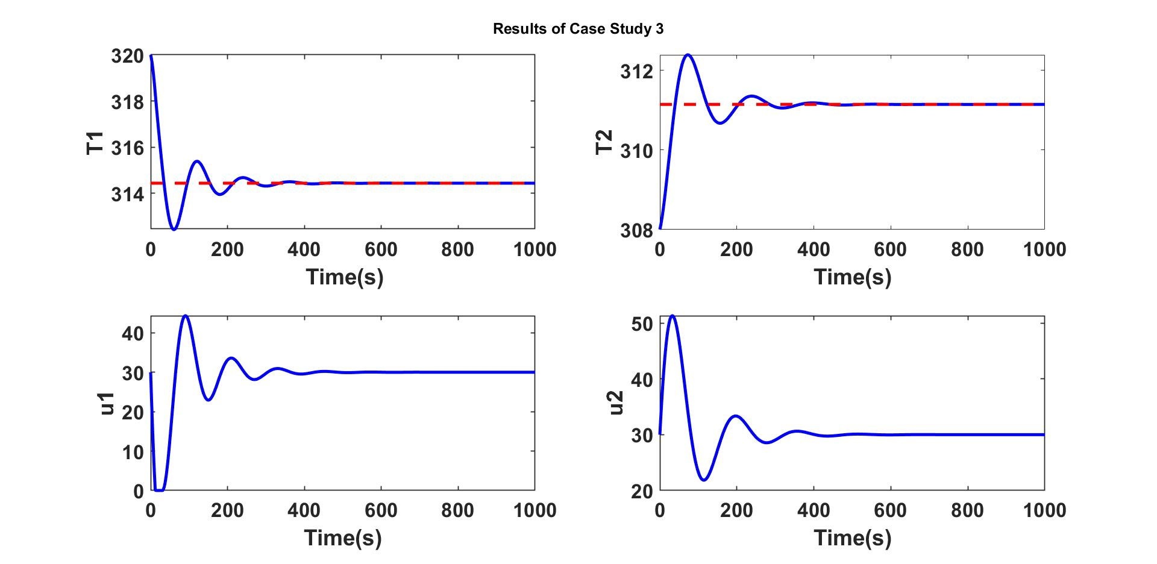
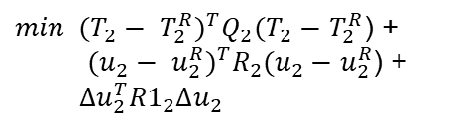

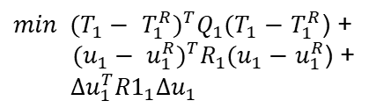
Bilevel Model predictive control (BMPC)
Explicit Hierarchical Controller on TCLab
${min (T_{1}− T_{1}^{R})}^{T}Q_{1}(T_{1}−$ $T_{1}^{R}$) +
${ (u_{1}− u_{1}^{R})}^{T}R_{1}(u_{1}−$ $u_{1}^{R}$) +
$Δu_{1}^{T}{R1}_{1}Δu_{1}$
$$u_{1}$$
${min (T_{2}− T_{2}^{R})}^{T}Q_{2}(T_{2}−$ $T_{2}^{R}$) +
${ (u_{2}− u_{2}^{R})}^{T}R_{2}(u_{2}−$ $u_{2}^{R}$) +
$Δu_{2}^{T}{R1}_{2}Δu_{2}$
$$u_{2}$$
Case Study 3
TCLab system is a simple MIMO device.
Explicit MPC and Hierarchical Controller algorithms were
easy to understand.

Slide 22
Future Work
A better understanding of solving Hierarchical MPC Control structures
Extending the BMPC algorithm to more complex systems like buildings in
the future.
Started with a simple system
Strengthening the understanding of bilevel and multilevel decision-making problems.
Reference: Ryu JH, Dua V, Pistikopoulos EN. A bilevel programming framework for enterprise-wide process networks under uncertainty.
Reference: Avraamidou, S. and Pistikopoulos, E.N., 2017. A multi-parametric bi-level optimization strategy for hierarchical model predictive control.

Slide 23
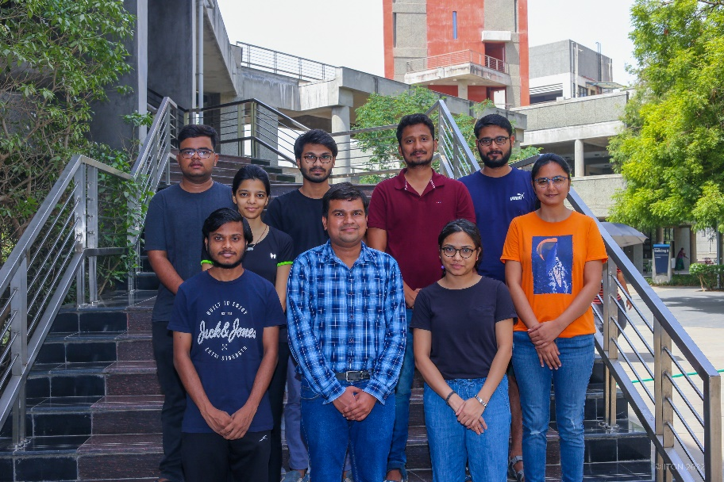

Acknowledgment
I am thankful to the Post-doc in our research group Dr. Radhe Saini for his guidance during my course project.
I am also thankful to Prof. Hari S. Ganesh’s research group
members for their support.
Thank You!

